Slide 1
Vincent van Gogh
(1853–1890)
Netherlands
History of Modern Art
BFA-III (Visual Arts)
Course Incharge: Ms. Sidra Liaqat
Institute of Design & Visual Arts, LCWU

Slide 2
Vincent van Gogh
(1853–1890)
Netherlands
“I put my heart and my soul into my work, and have lost my mind in the process.”
- Vincent van Gogh

Slide 3
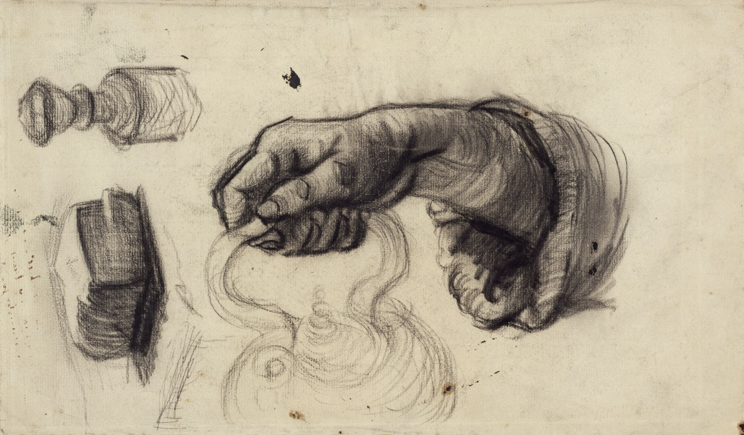
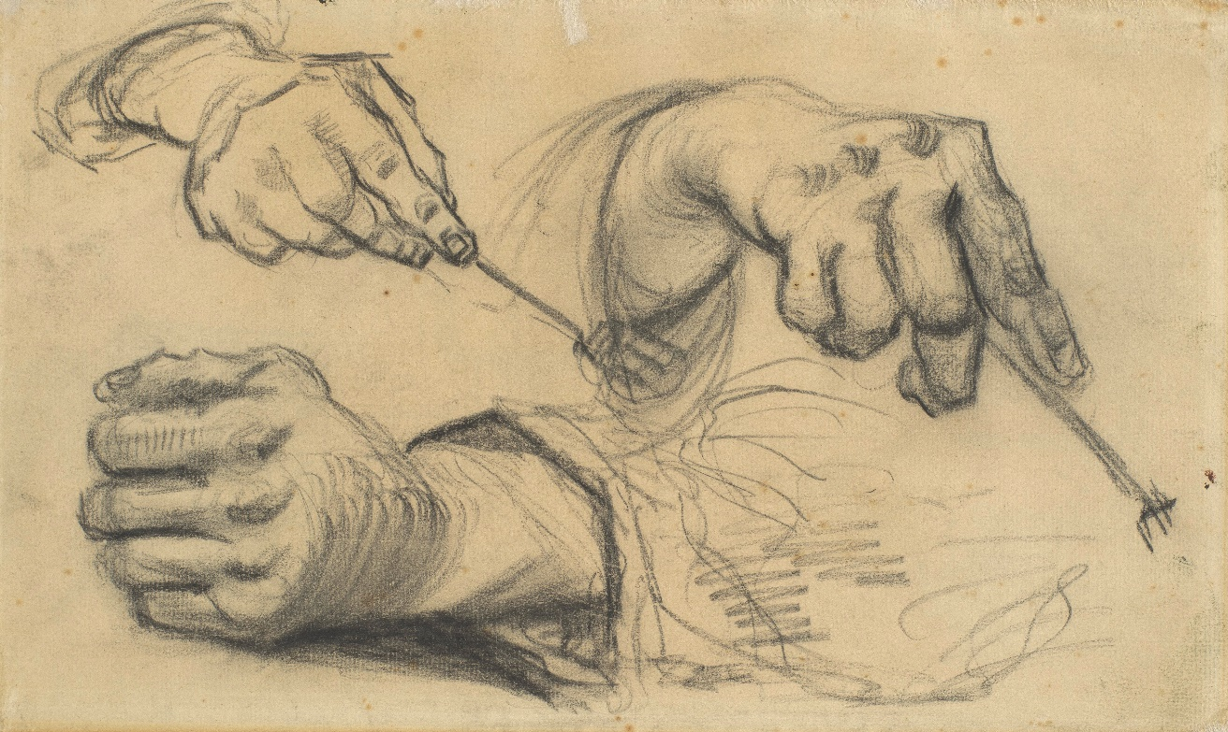
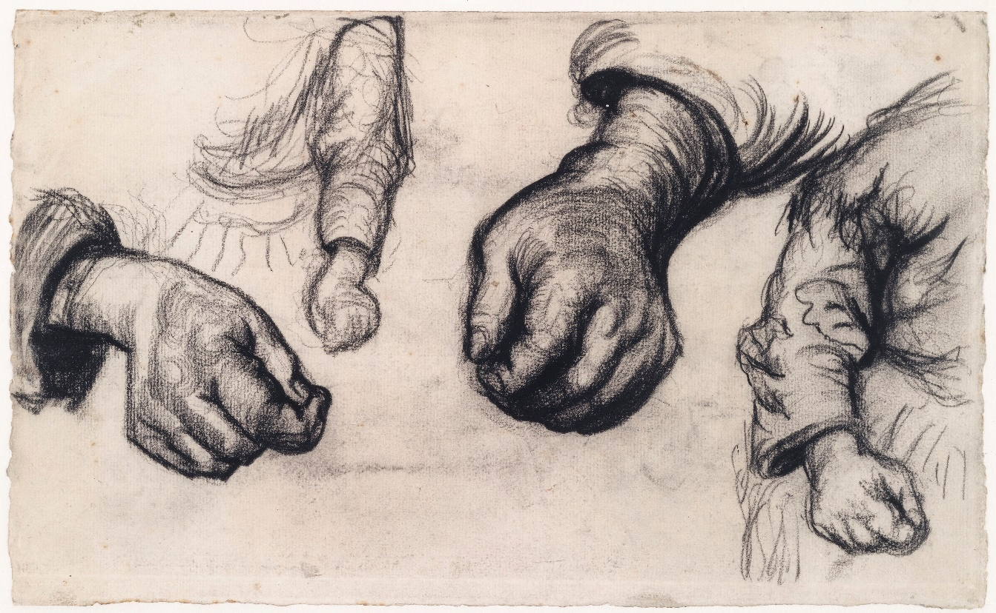
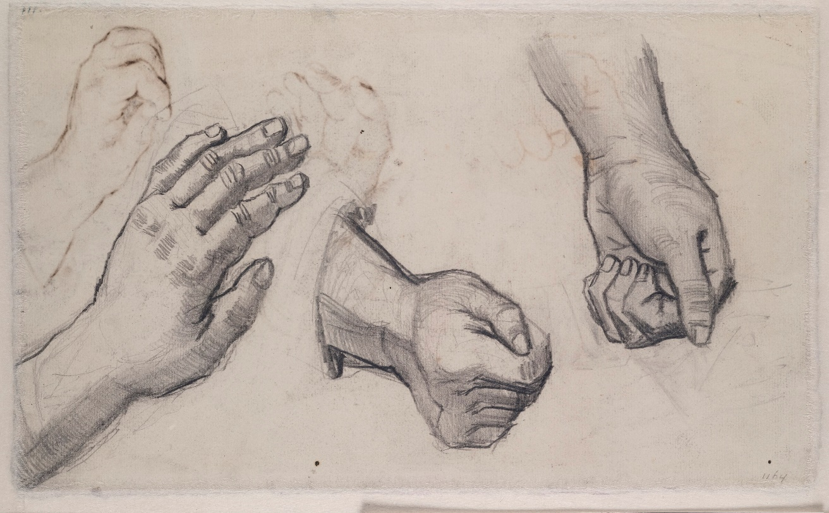

Slide 4
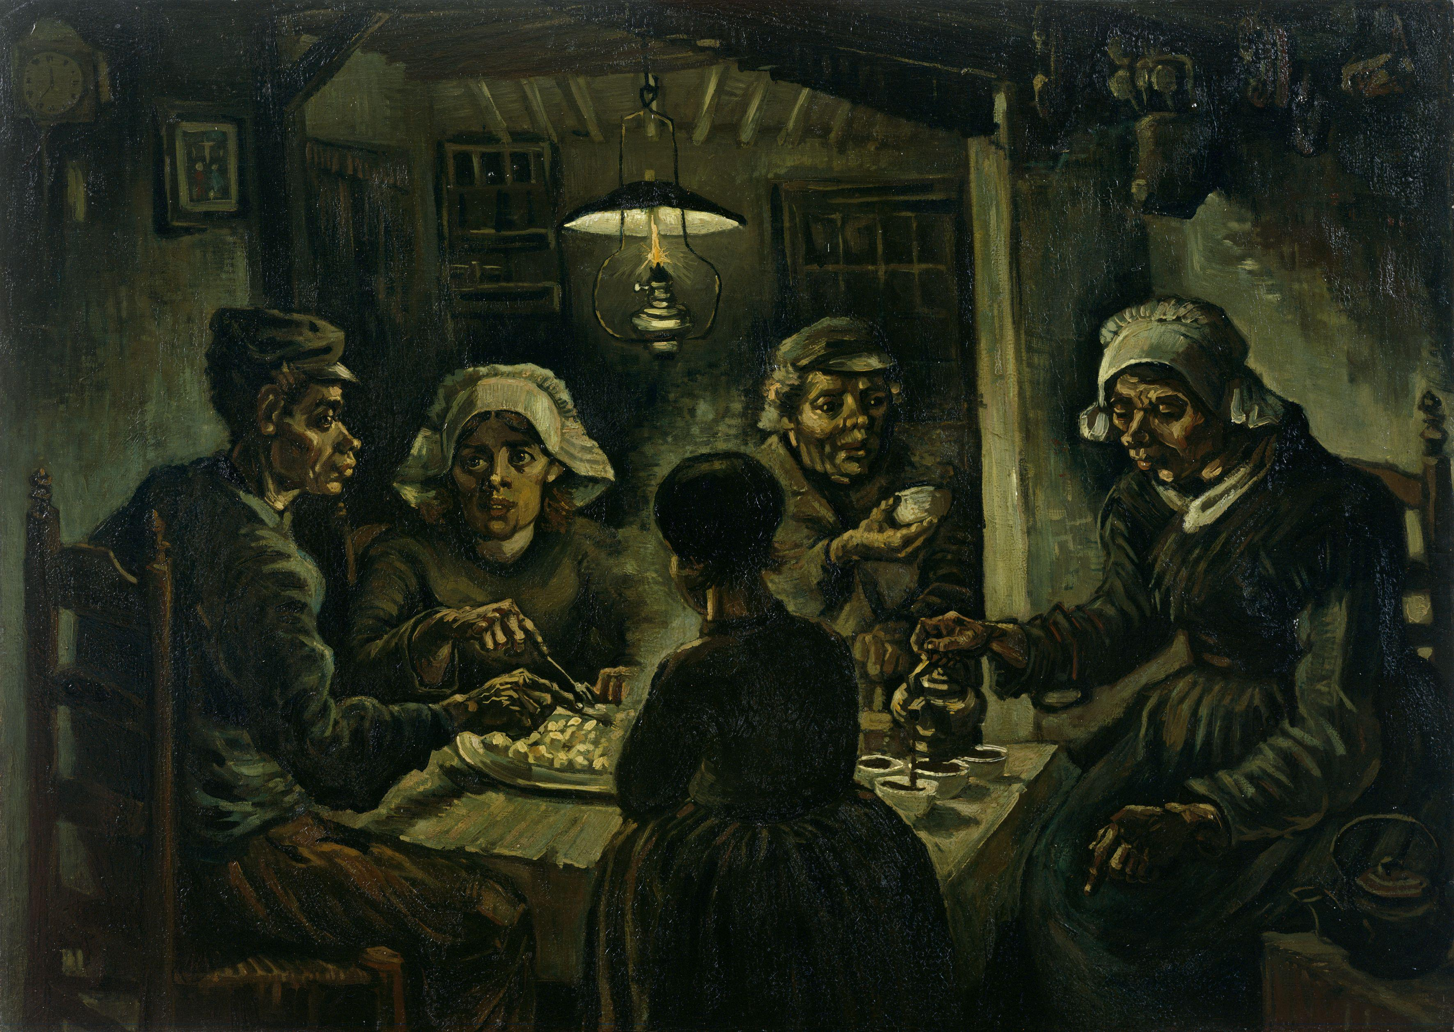
“I have tried to emphasize that those people, eating their potatoes in the lamplight, have dug the earth with those very hands they put in the dish, and so it speaks of manual labor, and how they have honestly earned their food.”
(A letter to Theo by Vincent)
“The Potato Eaters”
(1885)

Slide 5
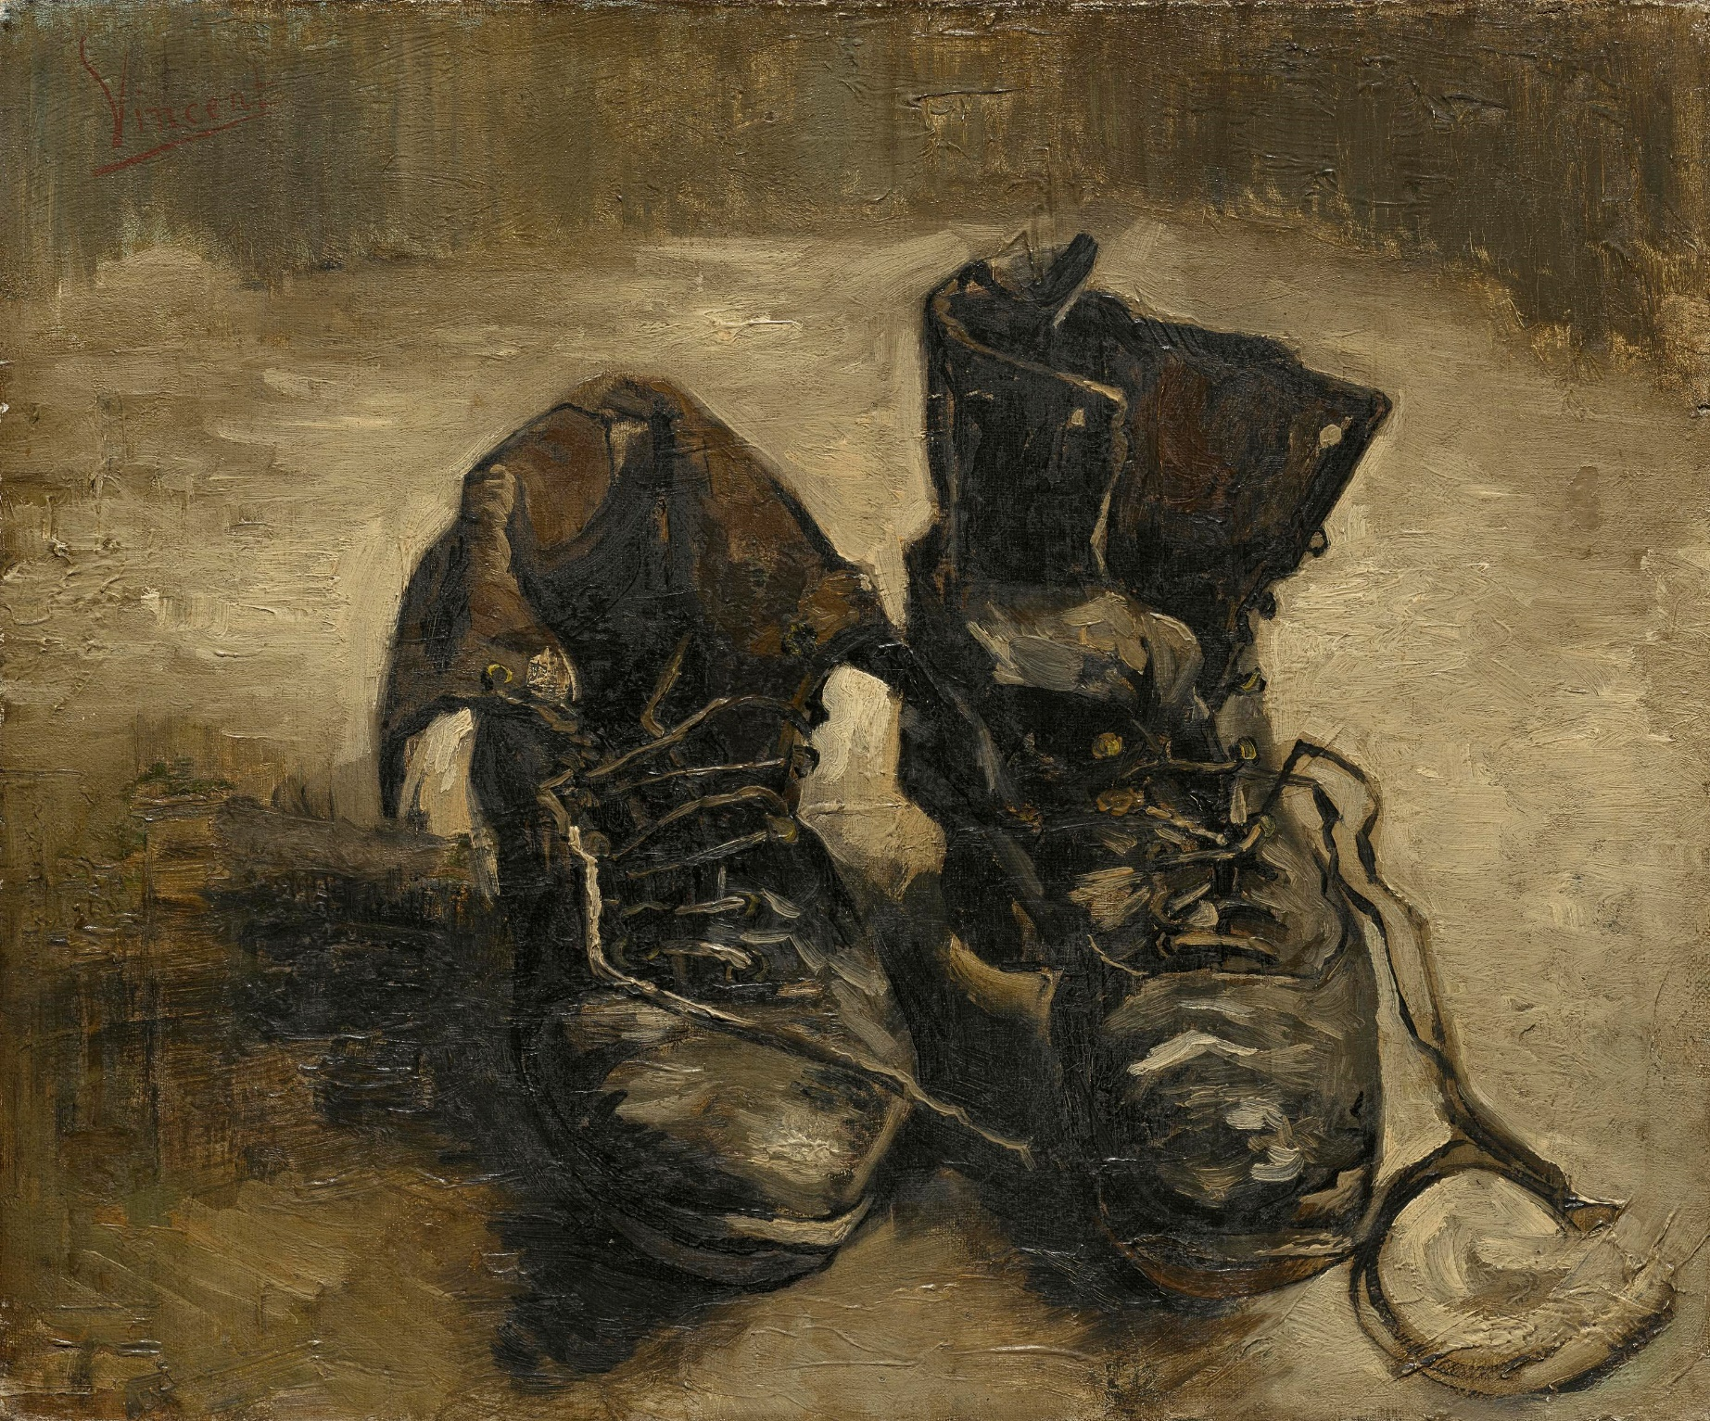
“Shoes” (1886)

Slide 6
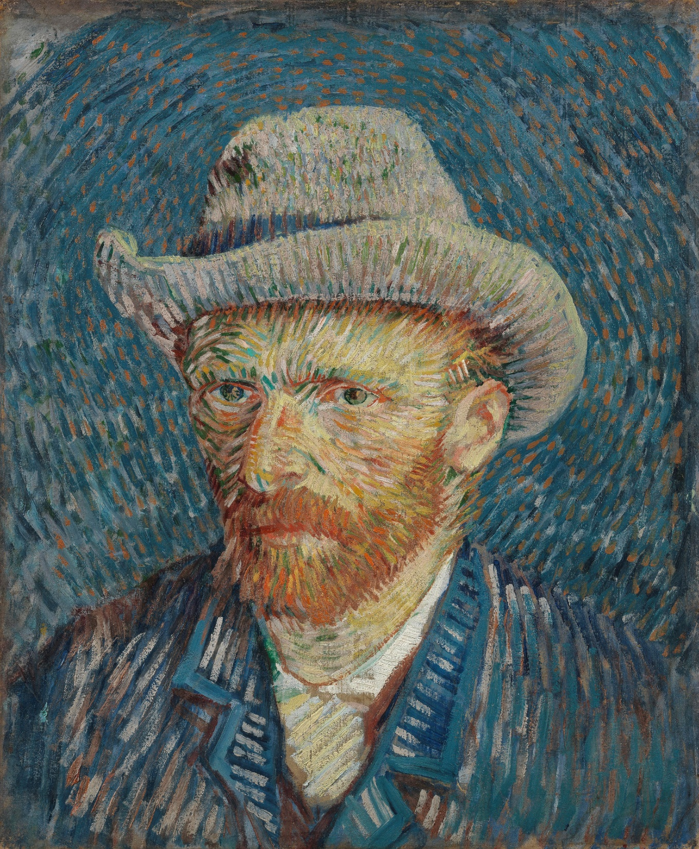
“Self-Portrait with Grey Felt Hat”
(1887)

Slide 7
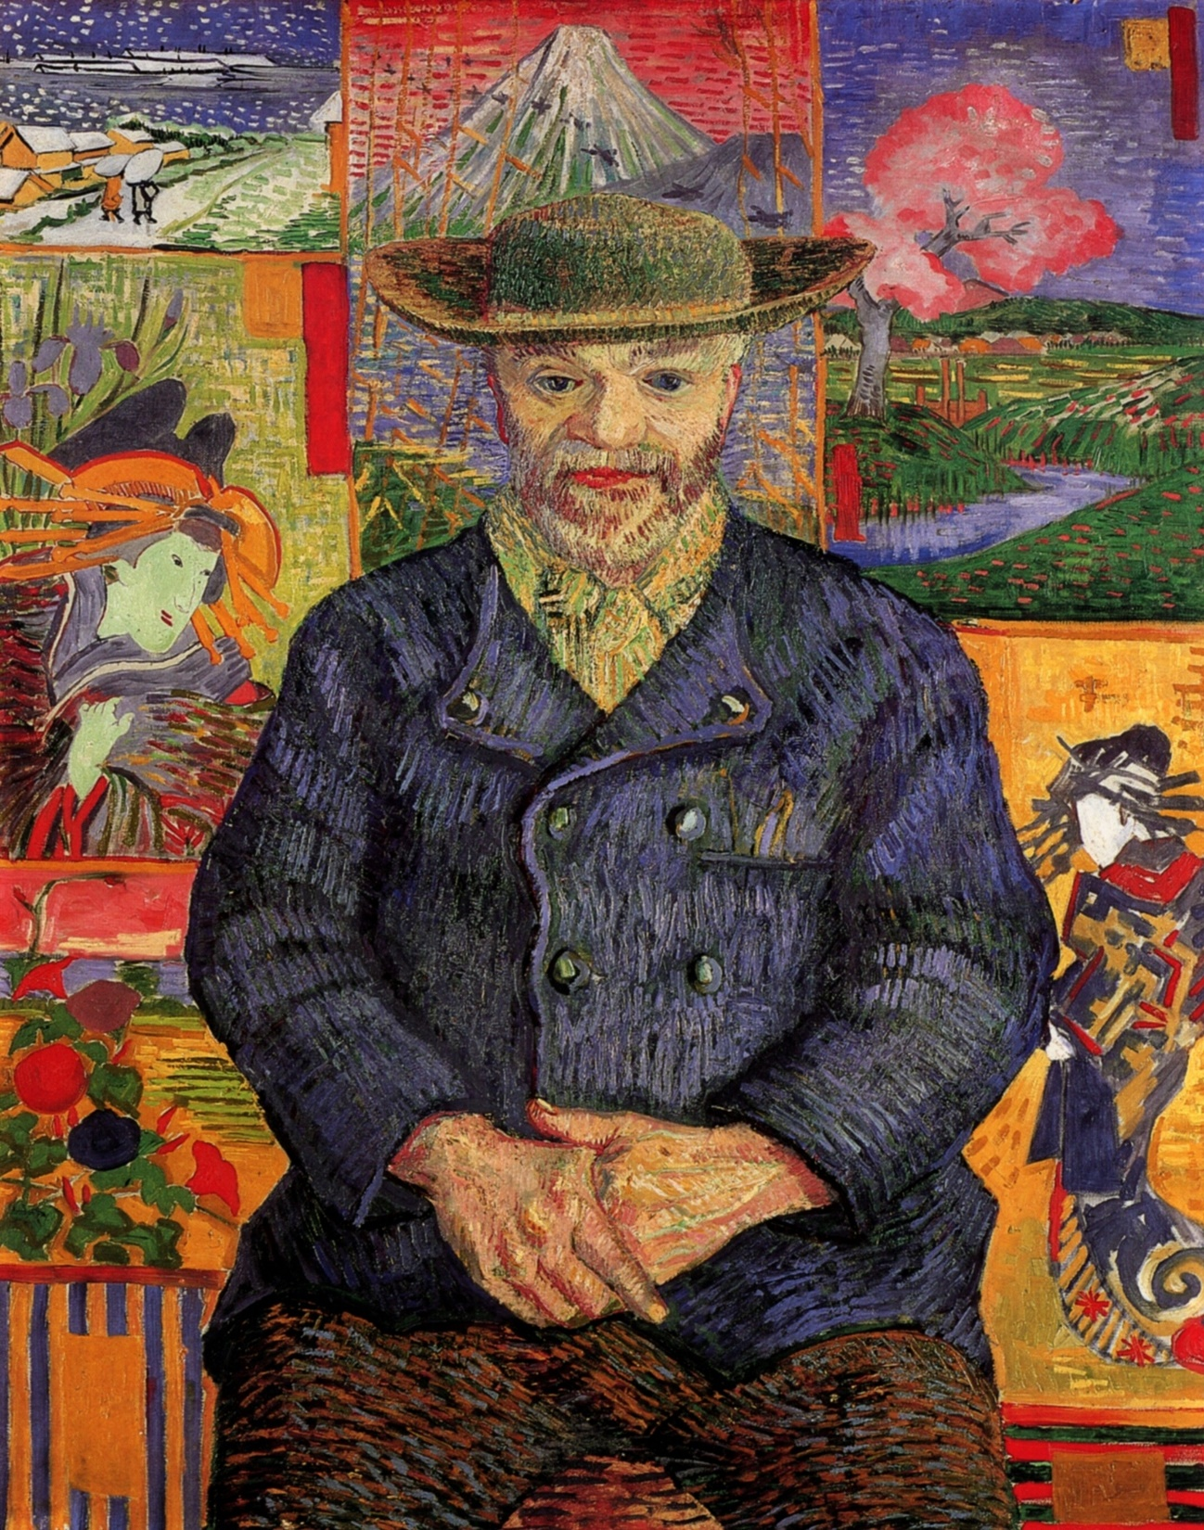
“Portrait of Père Tanguy”
(1887)

Slide 8
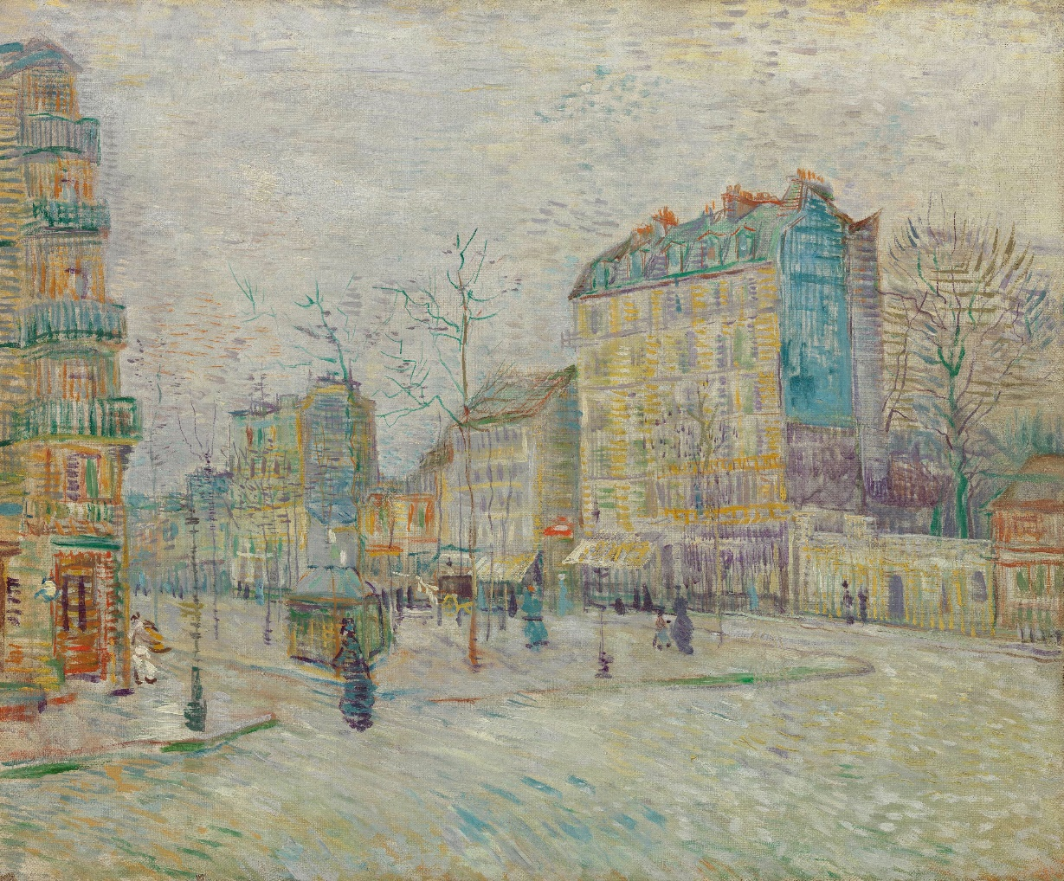
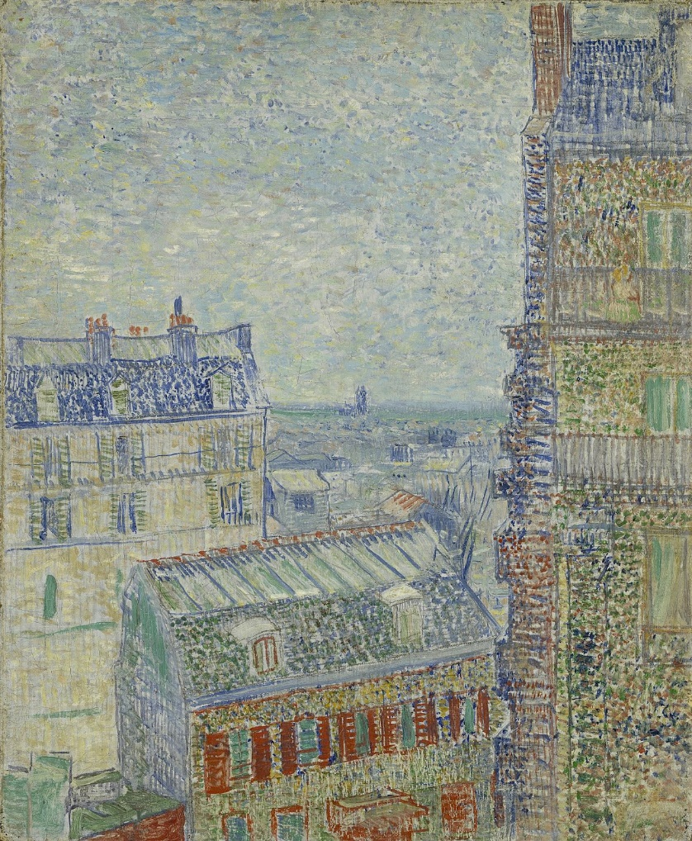
“The Boulevard de Clichy”
(1887)
“View from Vincent’s Room in Rue Lepic” (1887)

Slide 9
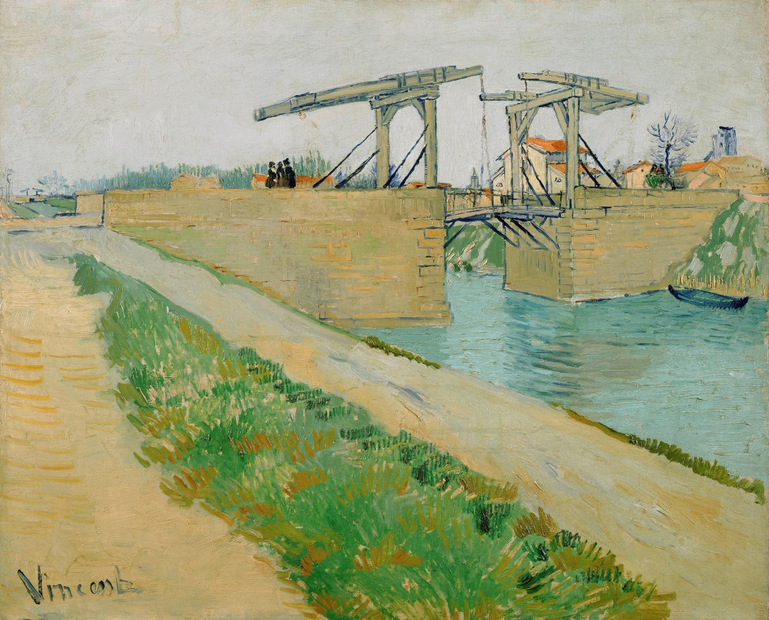
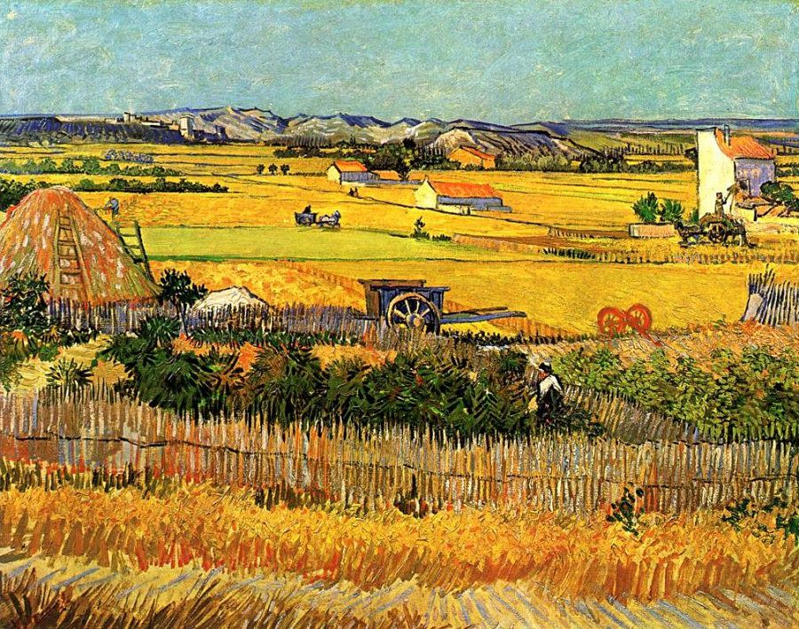
“The Bridge at Langlois” (1888)
“Harvest at La Crau” (1888)

Slide 10
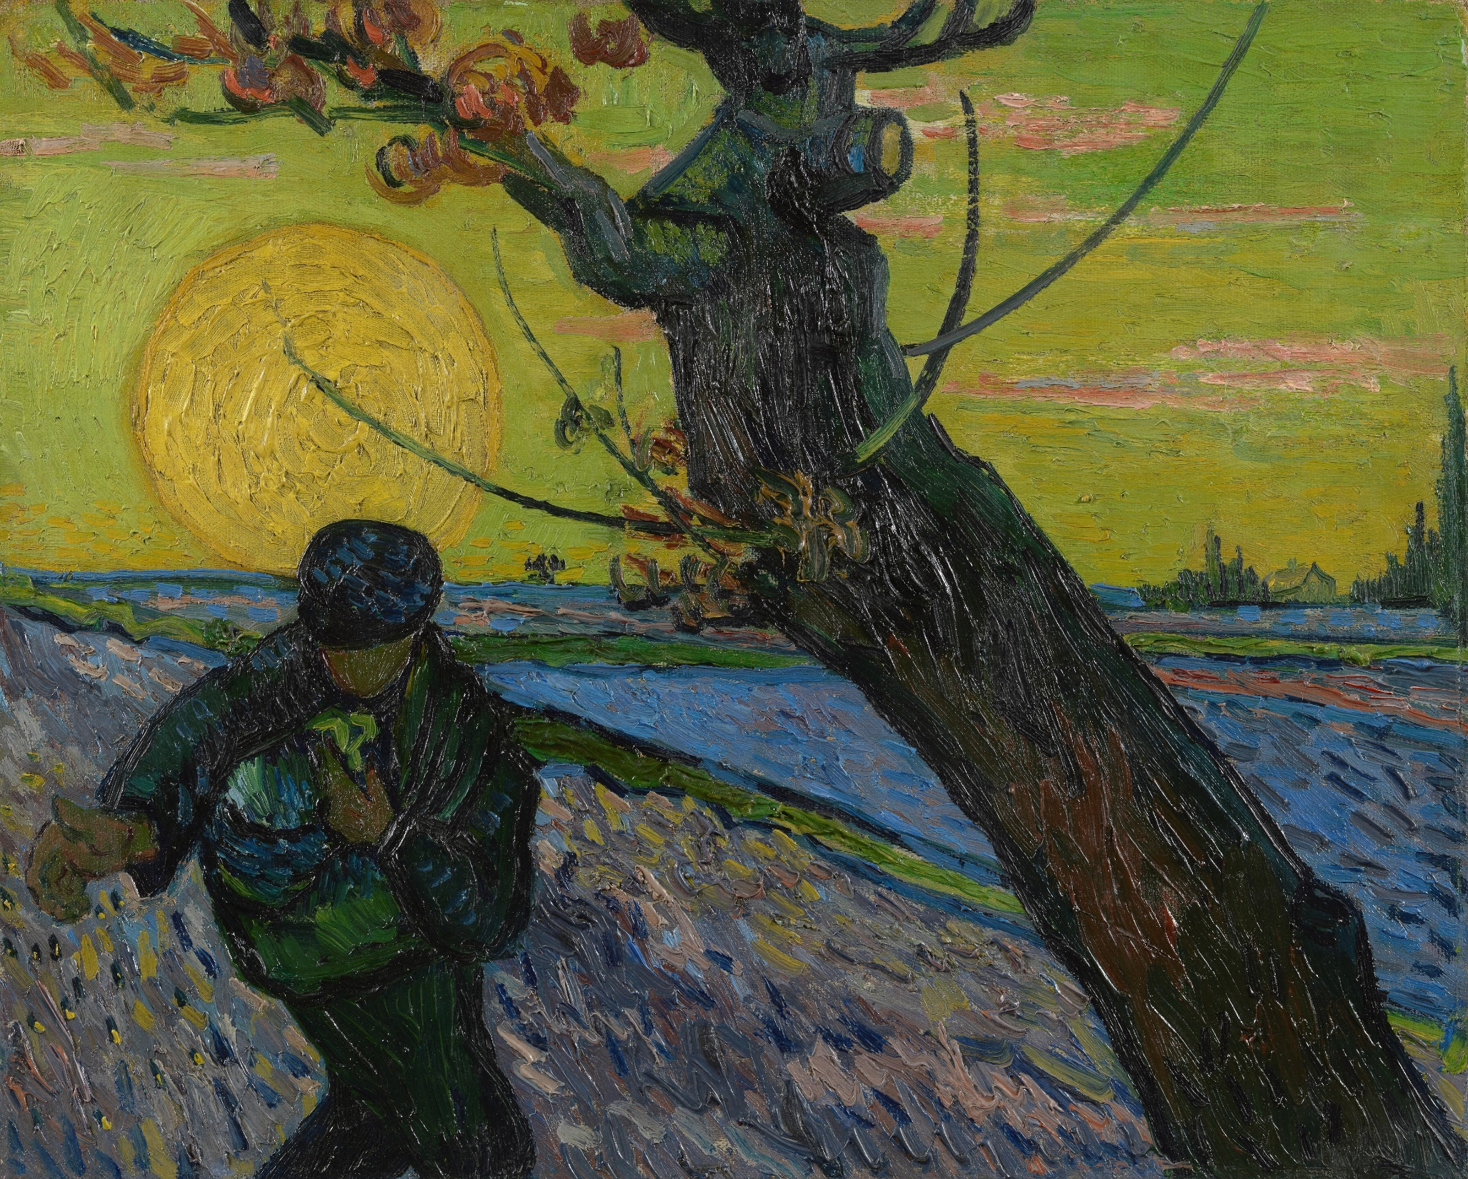
“The Sower”
(1888)

Slide 11
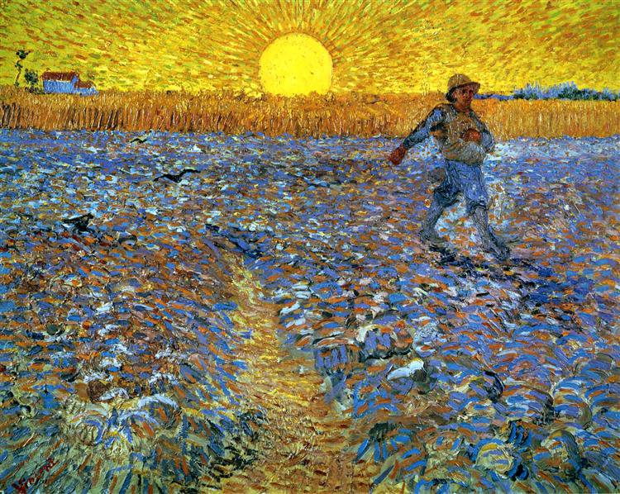
“Sower at Sunset”
(1888)

Slide 12
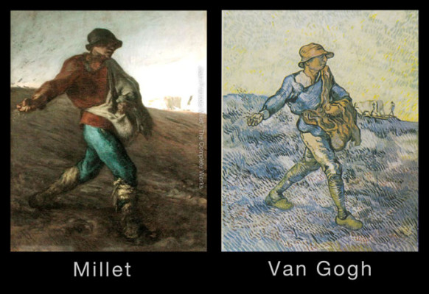
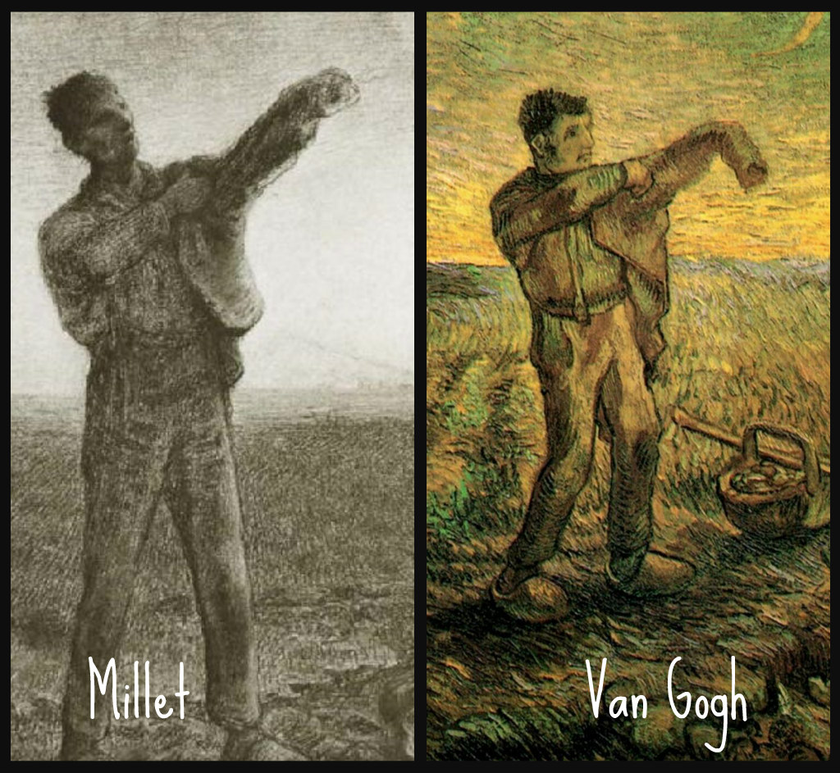
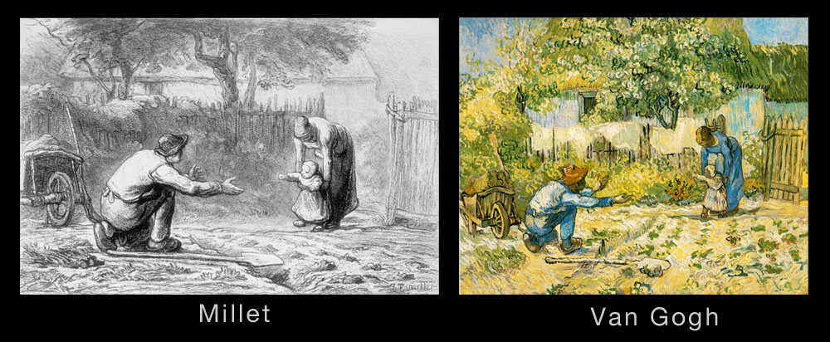

Slide 13
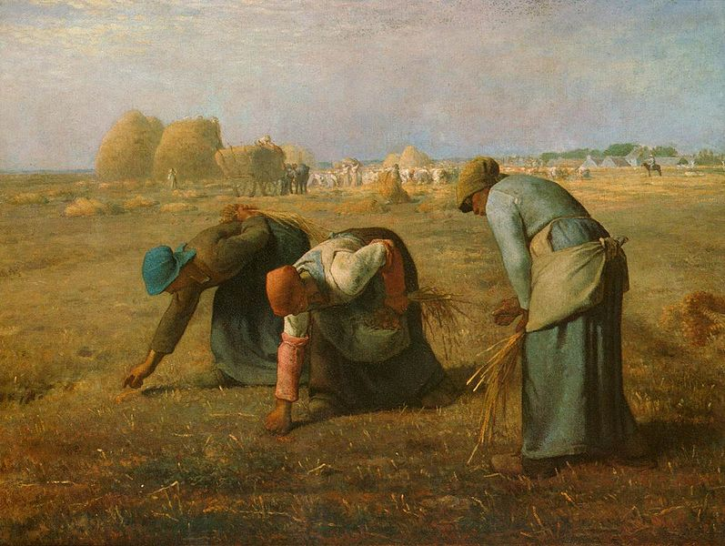
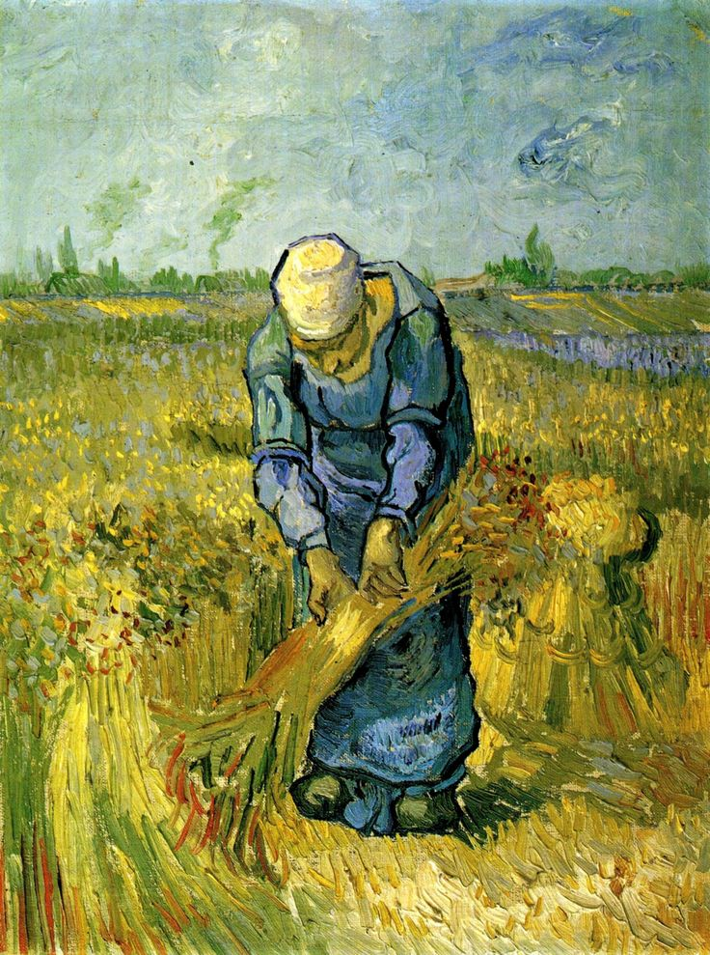
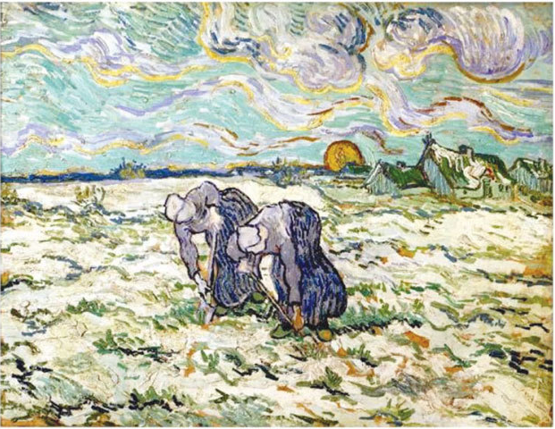
Millet
Van Gogh

Slide 14
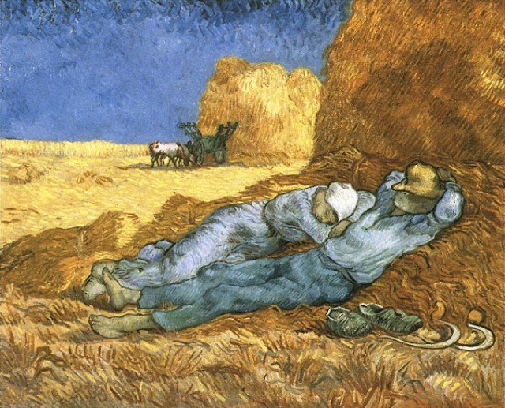
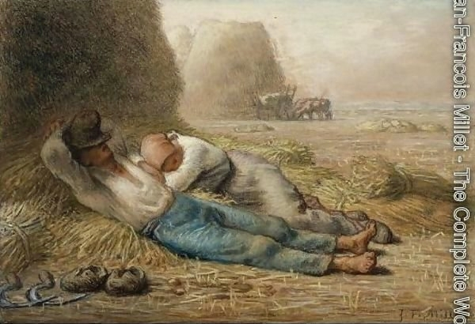
Millet
Van Gogh

Slide 15
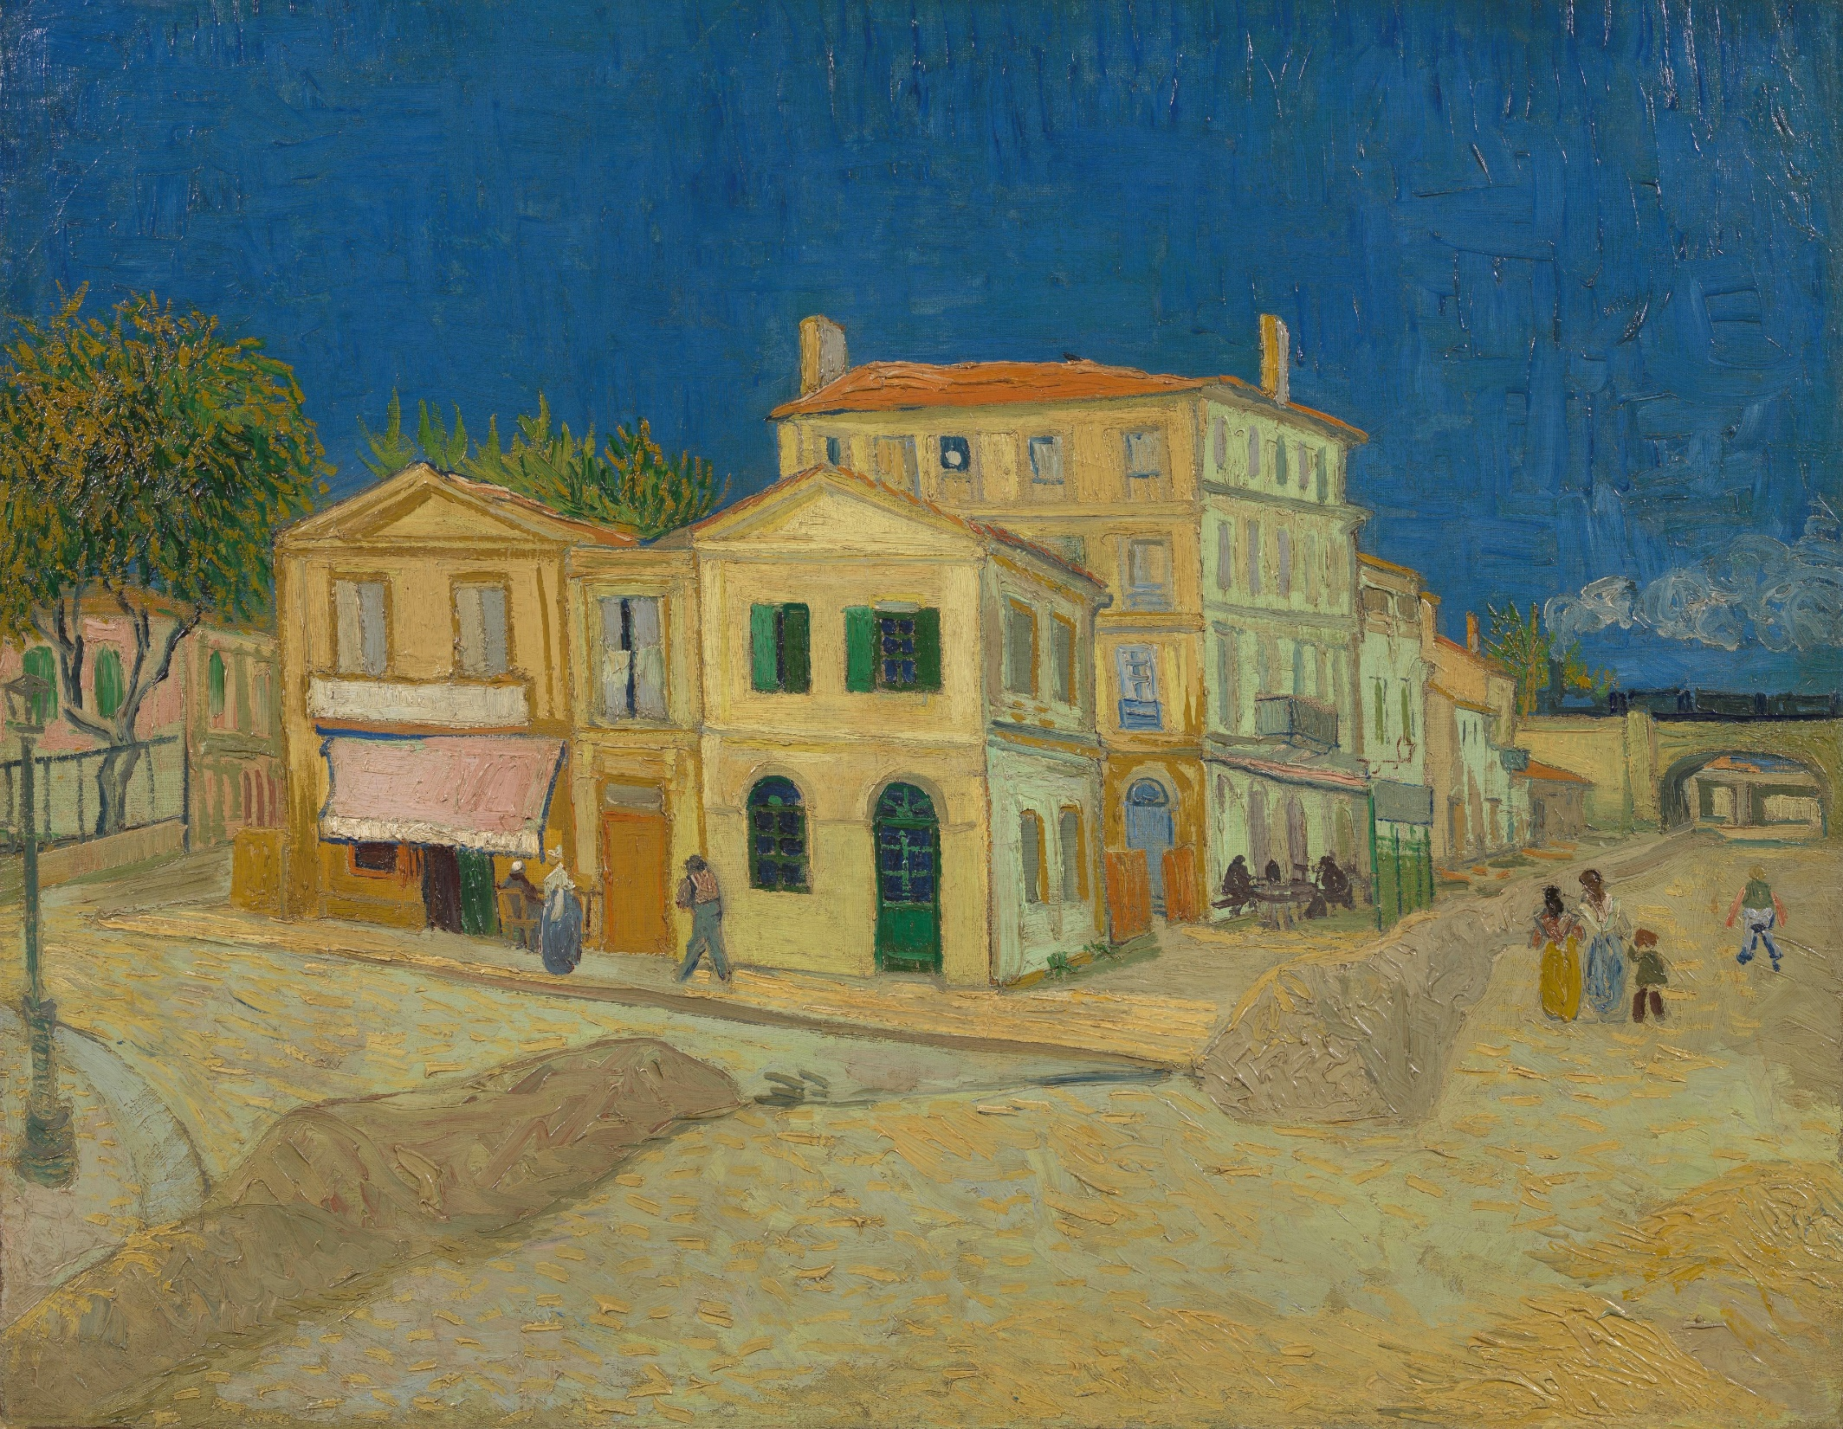
“The Yellow House”
(1888)

Slide 16
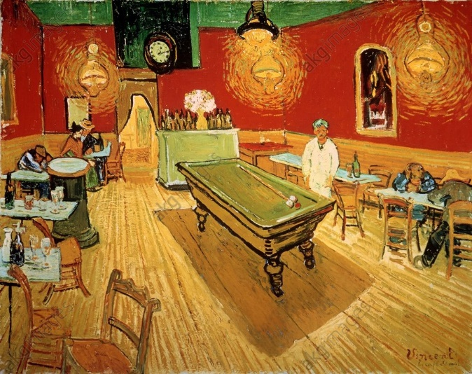
“I use color more arbitrarily, in order to express myself more forcibly.”
(A letter to Theo by Vincent)
“I have tried to express the terrible passions of humanity by means of red and green.”
(A letter to Theo by Vincent)
“Night Café - Interior”
(1888)

Slide 17
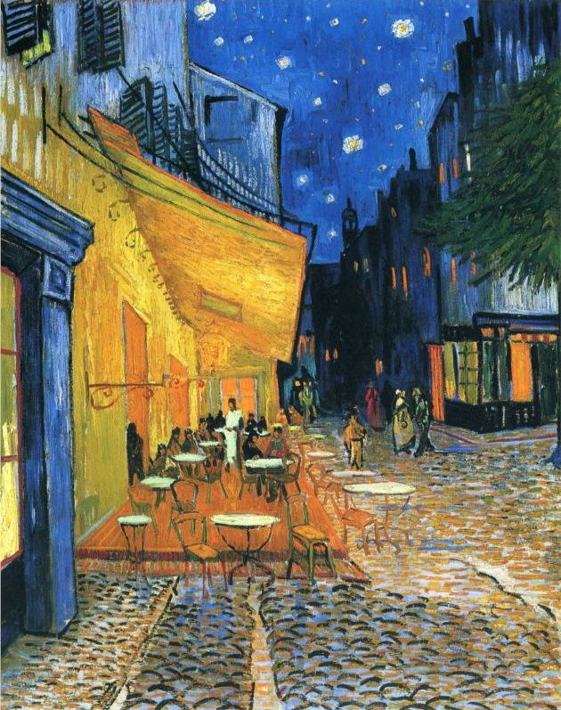
“Night Café - Exterior” /
“The Café Terrace at Arles at Night”
(1888)

Slide 18
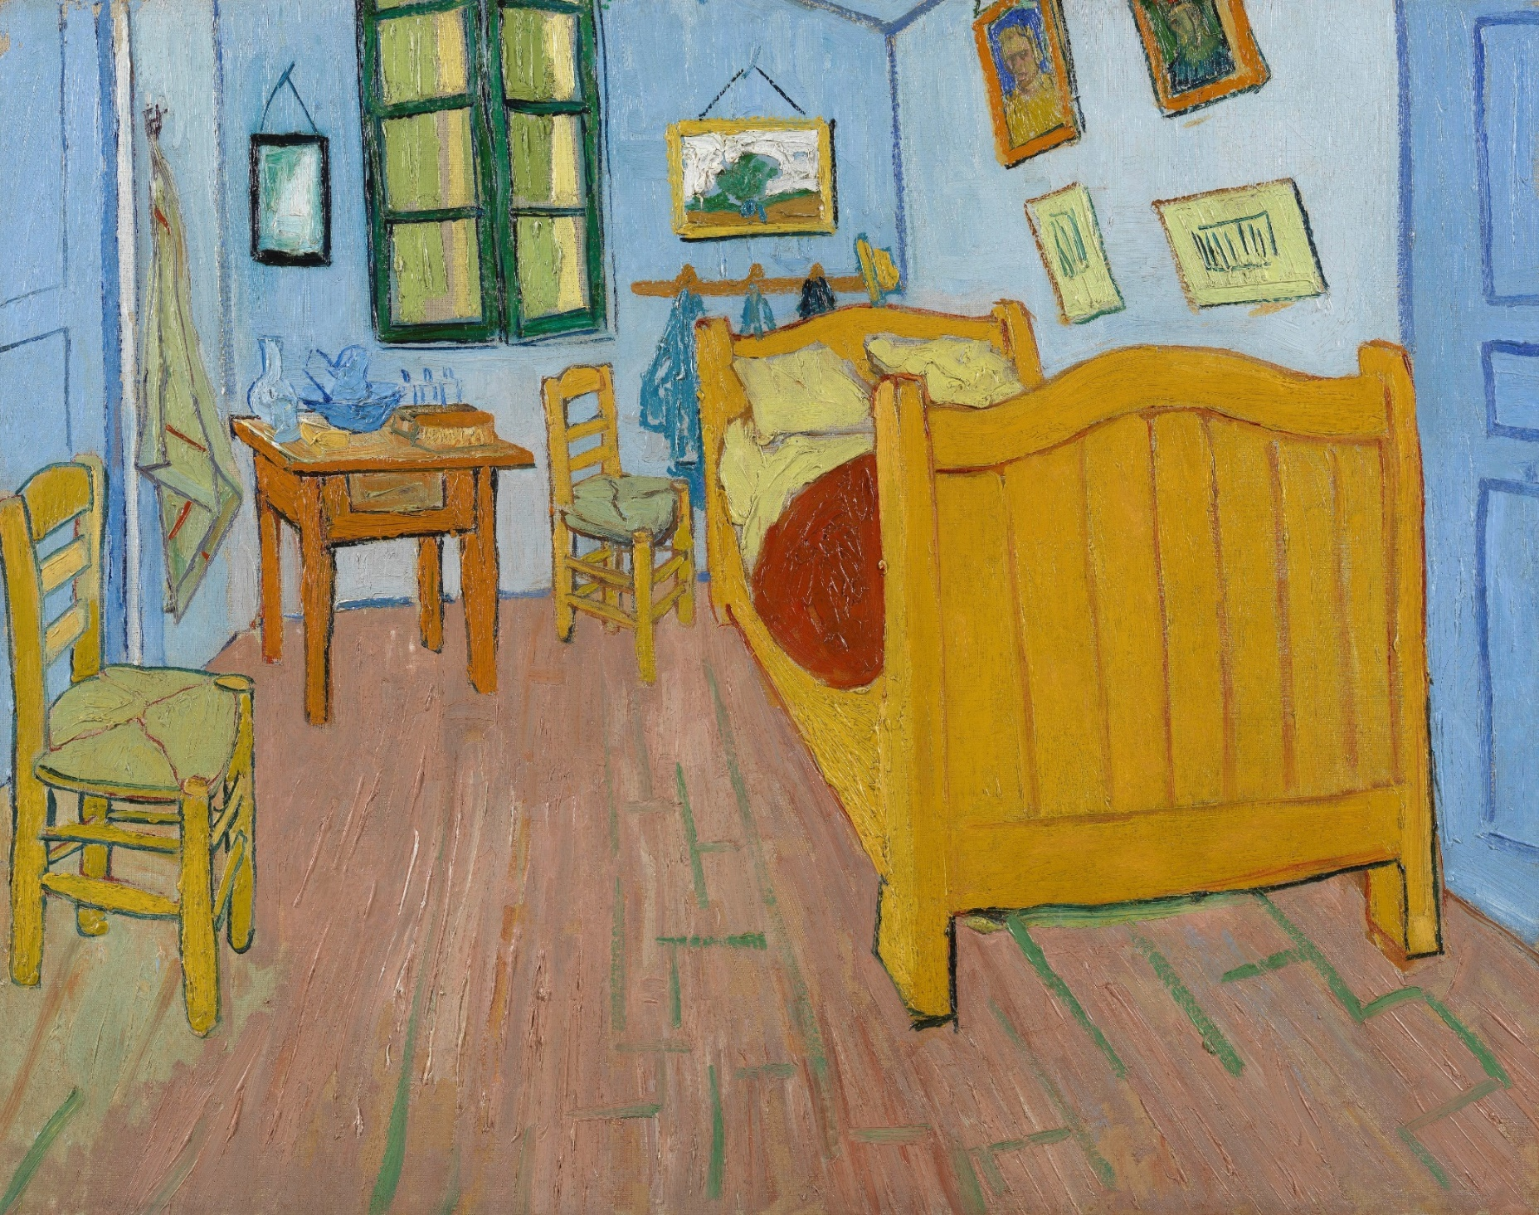
“Van Gogh’s Bedroom at Arles”
(1888)

Slide 19
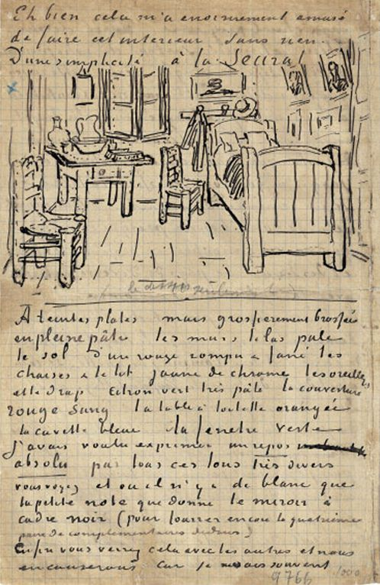
“This time it is quite simply my bedroom, only here the color must do the work… That is, to suggest rest or sleep in general. This is a bedroom where you should be able to rest your head, or, rather, your imagination… the squareness of the furniture should express uninterruptable rest.”
(A letter to Theo by Vincent)
Van Gogh’s Letter to his Brother Theo van Gogh

Slide 20
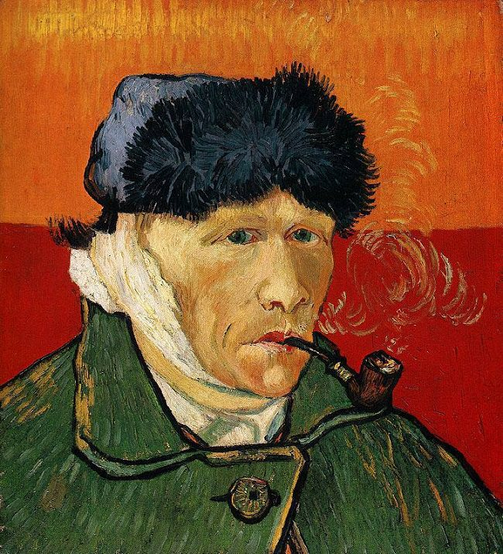
“Self-Portrait with Bandaged Ear and Pipe” (1889)

Slide 21
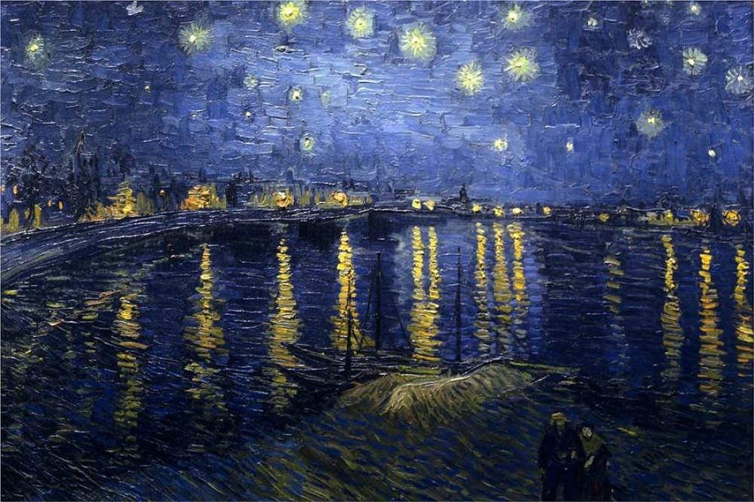

Slide 22
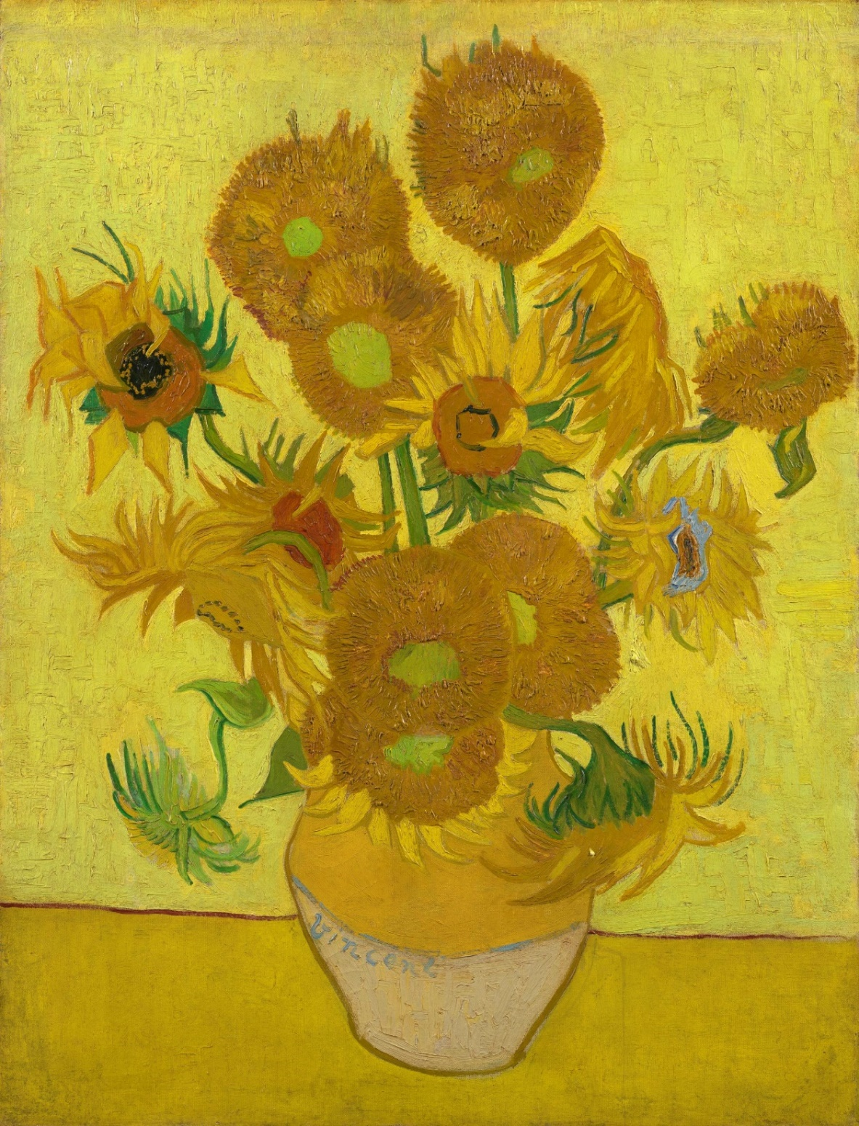
“Sunflowers” (1889)

Slide 23
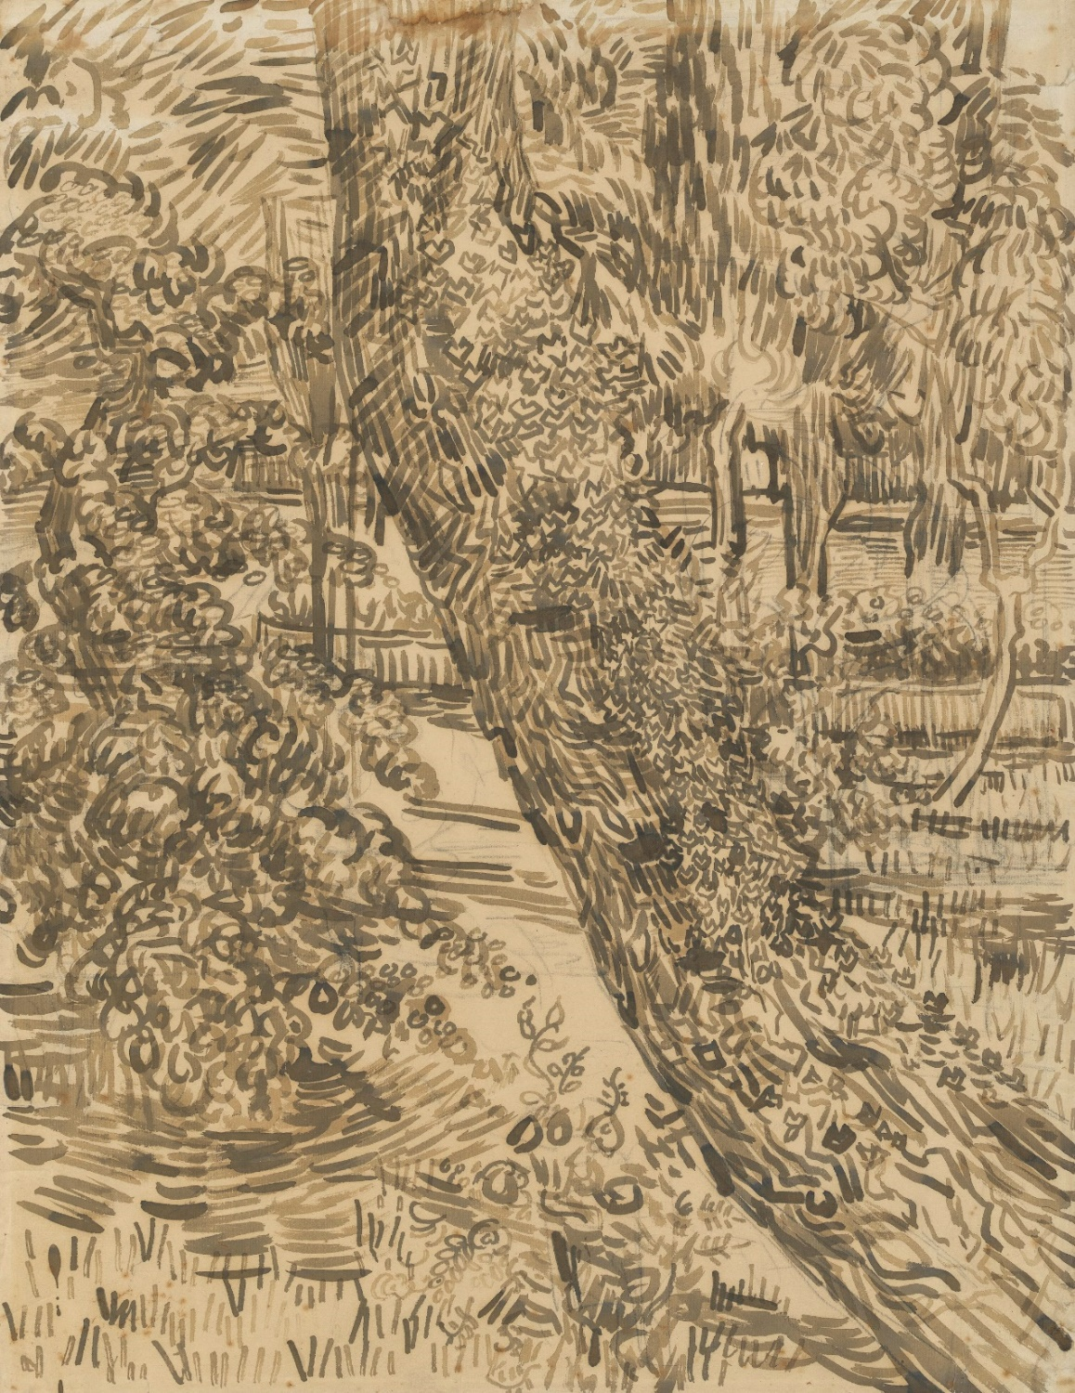
“Tree with Ivy in the Garden of the Asylum”
(1889)

Slide 24
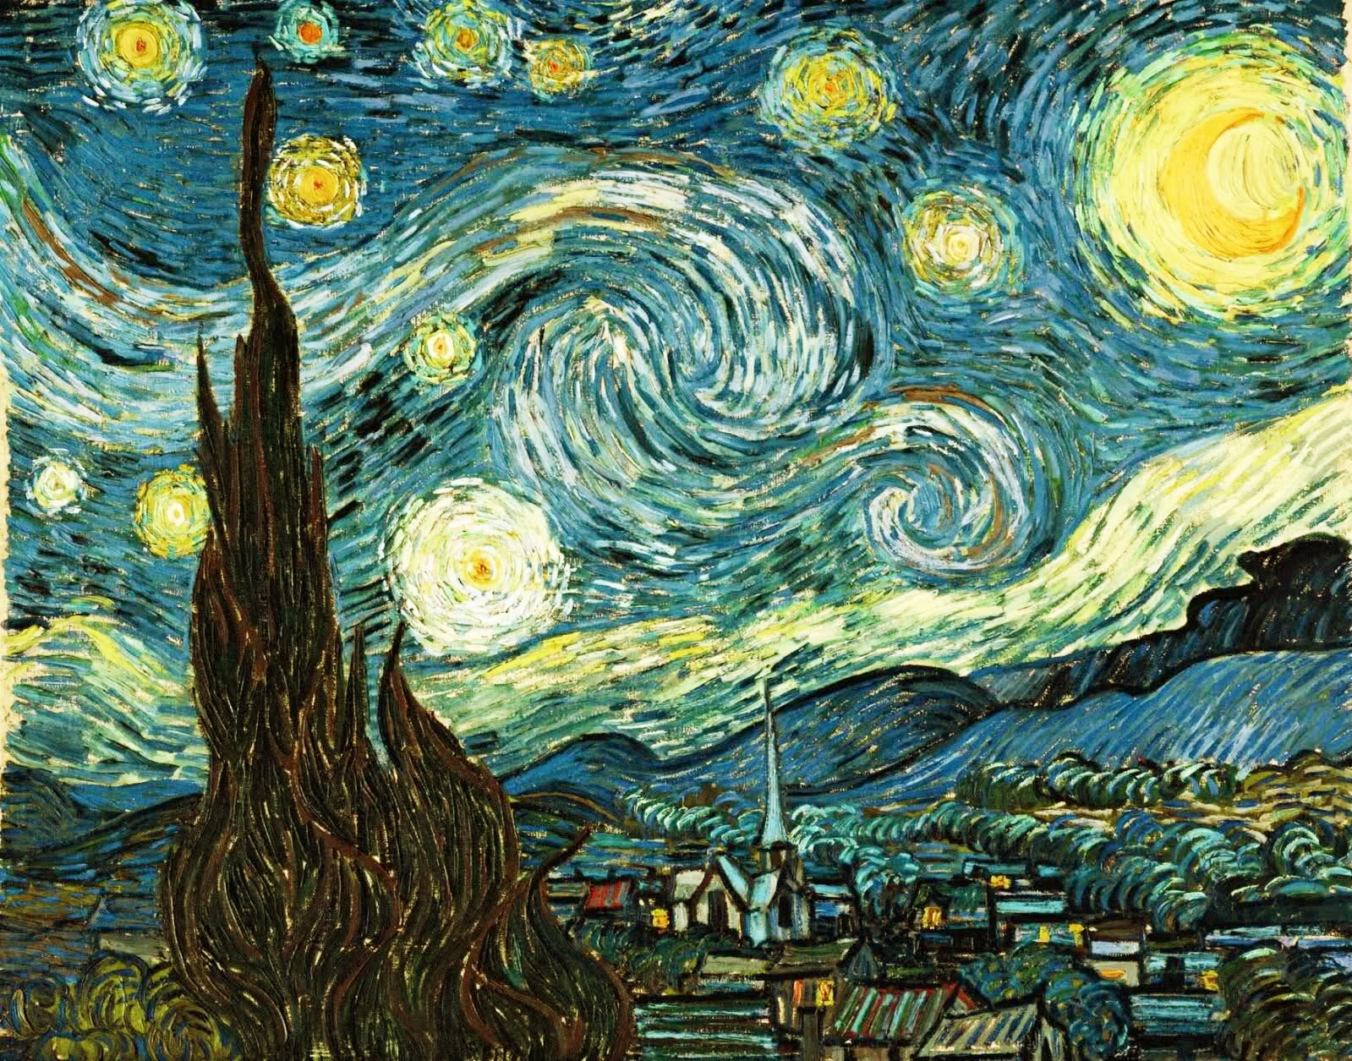
“It often seems to me that the night is much more alive and richly colored than the day.”
(A letter to Theo by Vincent)
“The Starry Night”
(1889)

Slide 25
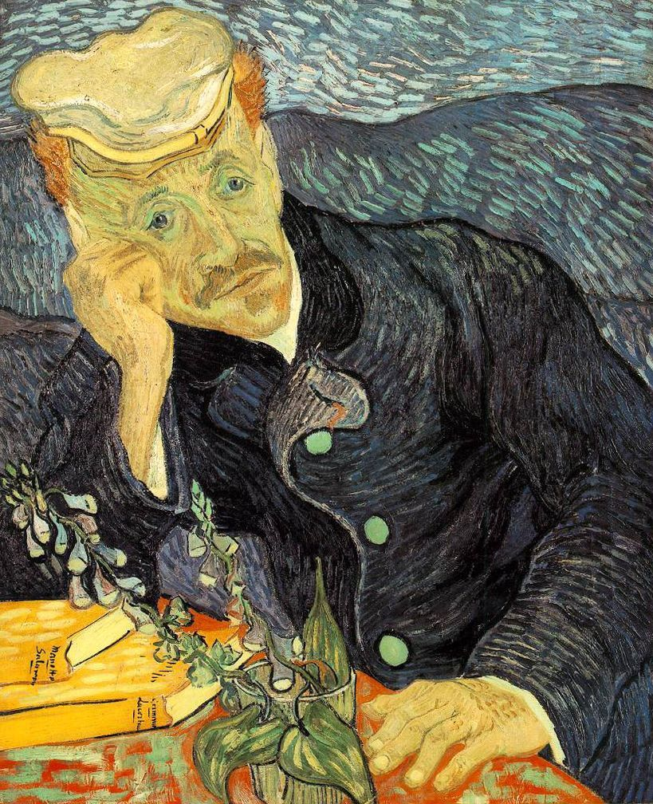
“Portrait of Dr. Gachet” (1890)

Slide 26
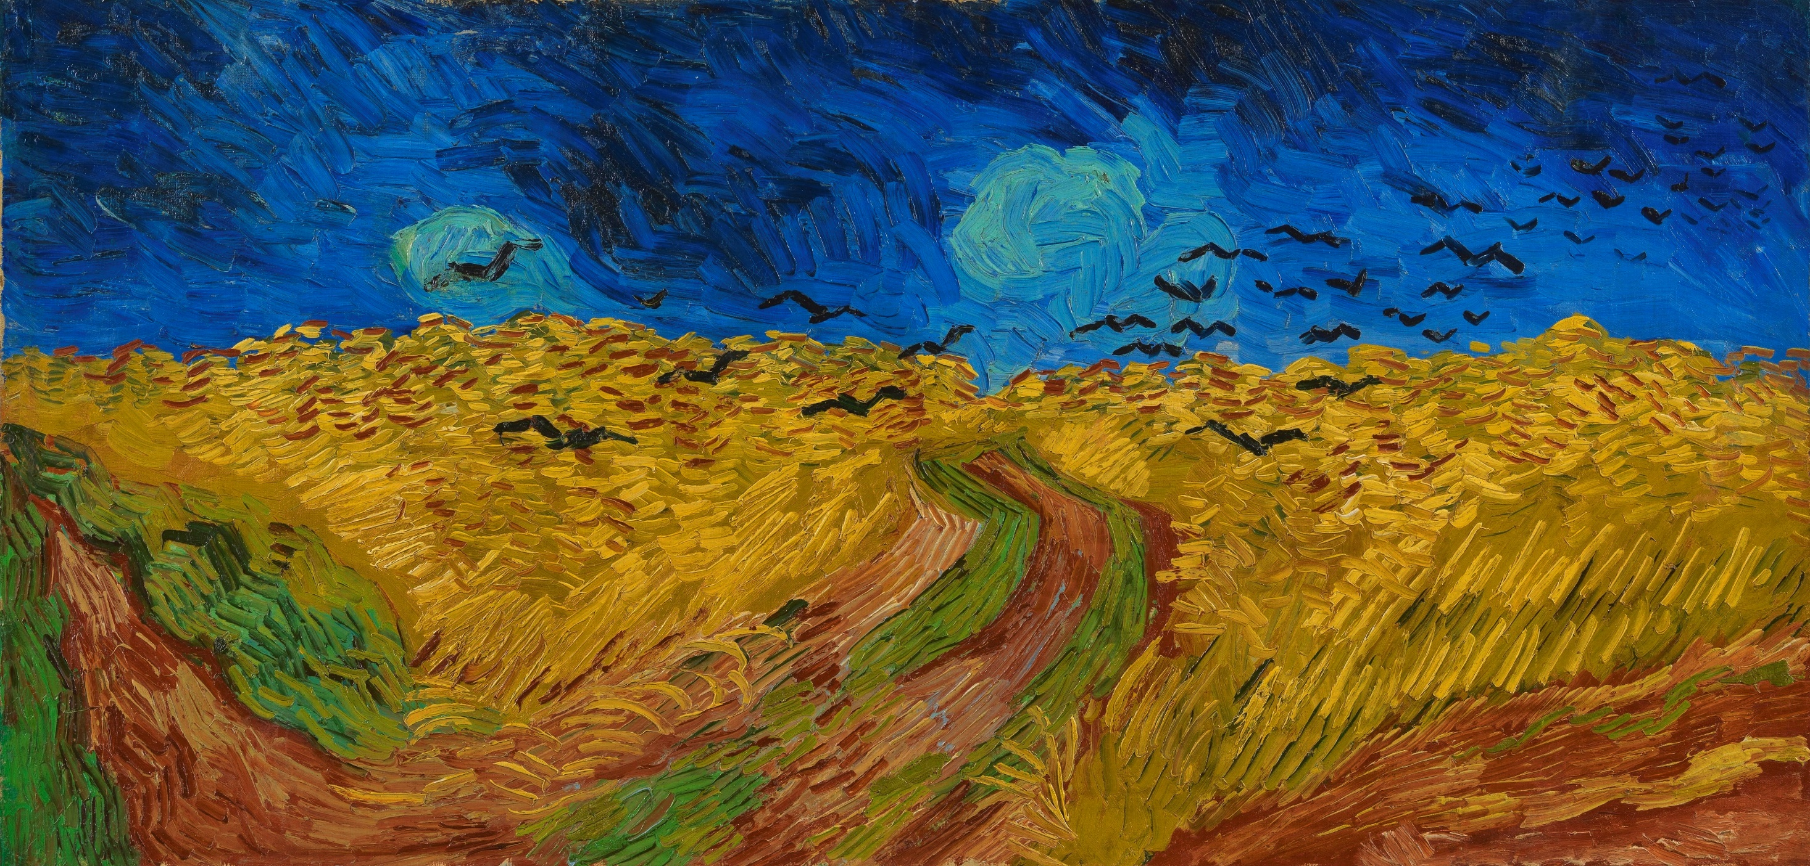
“Wheatfield with Crows”
(1890)

Slide 27
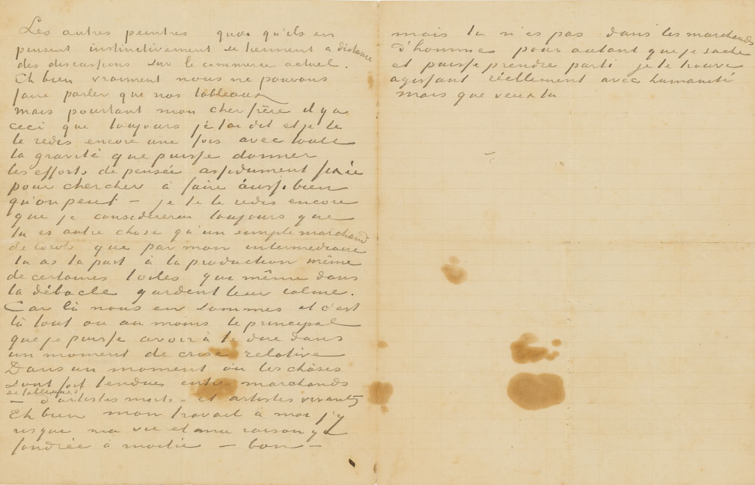
“Ah well, I risk my life for my own work and my reason
has half foundered in it. (…) But what can you do...”
The final sentence of the unfinished letter to Theo, stained with blood and
with a note in Theo’s hand: ‘The letter he had on him on 27 July, that horrible day.’

